Slide 1
Introducing Endangered Species
Developed by the Endangered Species Coalition for the Endangered Species Day Curriculum

Slide 2
What do it Mean?
Threatened
Endangered
Extinct

Slide 3
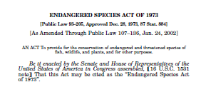
Endangered Species Act

Slide 4
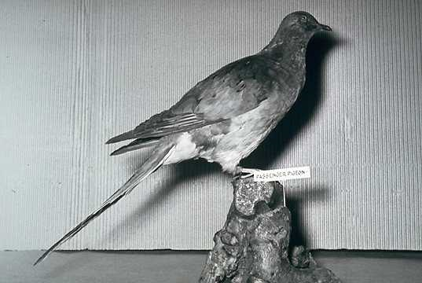
Passenger Pigeon
Notes:
TitlePassenger Pigeon
CreatorGoldman, Luther
SubjectBirds; extinction PublisherU.S. Fish and Wildlife Service
ContributorsDIVISION OF PUBLIC AFFAIRS
TypeStill image FormatJPG SourceWO545Highlights LanguageEnglish
RightsPublic domain
AudienceGeneral

Slide 5
Bald Eagle
Notes:
TitleBald Eagle Alternative TitleHaliaeetus leucocephalus CreatorMenke, Dave DescriptionBald eagle draws wings back as it comes into the nest for a landing. Bald eagles generally lay 2 to 3 eggs in a large nest made of sticks and smaller twigs in tall trees or on rocky cliffs. SubjectAlaska Kodiak Island Raptors Birds of prey PublisherU.S. Fish and Wildlife Service ContributorsNATIONAL CONSERVATION TRAINING CENTER-PUBLICATIONS AND TRAINING MATERIALS TypeStill image FormatJPG SourceWV -10673 LanguageEnglish RightsPublic domain

Slide 6
Whooping Crane
Notes:
TitleCrane, whooping (B003)
Alternative TitleGrus americana
PublisherU.S. Fish and Wildlife Service
TypeStill image FormatJPG LanguageEnglish
RightsPublic domain
AudienceGeneral

Slide 7
Humpback Whale
Notes:
Humpback Whale (Megaptera novaeangliae) Photo: NOAA

Slide 8
Florida Panther
Notes:
TitleFlorida Panther SubjectCarnivore Predators cat Endangered species Florida PublisherU.S. Fish and Wildlife Service ContributorsDIVISION OF PUBLIC AFFAIRS TypeStill image FormatJPG SourceWO2883-Highlights LanguageEnglish RightsPublic domain

Slide 9
American Alligator
Notes:
TitleAmerican Alligator CreatorStolz, Gary M. SubjectAnimals Louisiana Reptiles Wildlife PublisherU.S. Fish and Wildlife Service ContributorsDIVISION OF PUBLIC AFFAIRS TypeStill image FormatJPG SourceWO8440-002 LanguageEnglish RightsPublic domain

Slide 10
Polar Bear
Notes:
TitleLarge Male Polar Bear Near Barrow, Alaska Contactmailto:nctcimages@fws.gov CreatorAmstrup, Steve DescriptionA large male polar bear walks on the Arctic coast near Barrow, Alaska SubjectMammals Snow LocationAlaska PublisherU.S. Fish and Wildlife Service Date of Original10 November 2010 TypeStill Image FormatJPG Item ID5165010564_0d5cbfdc5a_b SourceUSFWS Alaska Region/Flickr RightsPublic Domain

Slide 11
Grizzly Bear
Notes:
TitleGrizzly bear Contactmailto:nctcimages@fws.gov CreatorBauer, Erwin & Peggy DescriptionGrizzly bear on a rock overlooking the Glacier National Park SubjectMammals Parks LocationMontana PublisherU.S. Fish and Wildlife Service TypeStill Image FormatJPG Item IDgrizzly bear_Bauer_9449_105.1 SourceNCTC Image Library RightsPublic Domain

Slide 12
Sea Otter
Notes:
TitleSea Otter CreatorMenke, David SubjectMarine mammals PublisherU.S. Fish and Wildlife Service Date of Original1995-08-17 TypeStill image FormatJPG SourceAK/RO/00174 LanguageEnglish RightsPublic domain

Slide 13
Spotted Owl
Notes:
TitleWO5490 Northern Spotted Owl CreatorHollingsworth, John and Karen Descriptionanimal; wildlife; McKenzie River; SubjectRaptors Endangered species Birds LocationOregon PublisherU.S. Fish and Wildlife Service ContributorsDIVISION OF PUBLIC AFFAIRS TypeStill image FormatJPG Item IDWO-5490-29 LanguageEnglish RightsPublic domain

Slide 14
Gray Wolf

Slide 15
Pacific Salmon
Notes:
TitlePacific Salmon Alternative TitleOncorhynchus CreatorKnepp, Timothy SubjectFishes fishes Fisheries management Art Illustrations illustrations PublisherU.S. Fish and Wildlife Service ContributorsDIVISION OF PUBLIC AFFAIRS TypeStill image FormatJPG SourceWO-ART-50-CDKnepp1 LanguageEnglish RightsPublic domain

Slide 16
Kirtland’s Warbler
Notes:
TitleKirtland's Warbler CreatorGeorge, Lou SubjectBirds PublisherU.S. Fish and Wildlife Service ContributorsDIVISION OF PUBLIC AFFAIRS TypeStill image FormatJPG SourceWO2499-15 LanguageEnglish RightsPublic domain

Slide 17
Karner Blue Butterfly
Notes:
TitleKarner Blue Butterfly CreatorHollingsworth, J & K SubjectInsects PublisherU.S. Fish and Wildlife Service ContributorsDIVISION OF PUBLIC AFFAIRS TypeStill image FormatJPG SourceWO-5309-020 LanguageEnglish RightsPublic domain

Slide 18
Pitcher Plant
Notes:
TitlePitcher plant Alternative TitleSarracenia purpurea Contactmailto:nctcimages@fws.gov CreatorBarnes, Dr. Thomas G.; DescriptionClose view of green plants with red veining. For additional resources about wildflowers visit the National Plants Database: National Plants Database http://plants.usda.gov/. SubjectFlowering plants Plants PublisherU.S. Fish and Wildlife Service ContributorsDr. Thomas Barnes/Universtiy of Kentucky Date of Original1980's TypeStill Image FormatJPG Item IDB3IMG0034.jpg SourceNCTC Image Library LanguageEnglish RightsPublic Domain

Slide 19
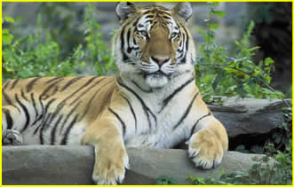
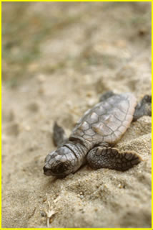
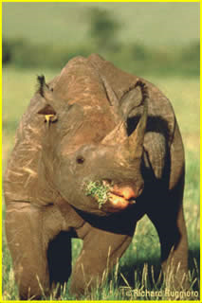
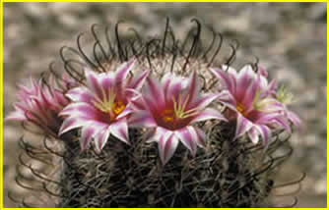
A Global Issue

Slide 20
Habitat Destruction
Notes:
TitleSpotted Owl Habitat Clear-cutting
Alternative TitleOregon
CreatorHillebrand, Steve
DescriptionThis is an example of a logging method known as clear-cutting. In clear-cutting, all the trees are taken from a specific area, as opposed to a select cut, in which only certain trees are taken from an area, thereby leaving some habitat remaining. PublisherU.S. Fish and Wildlife Service ContributorsDIVISION OF PUBLIC AFFAIRS TypeStill image FormatJPG SourceWO4912-Highlights LanguageEnglish
RightsPublic domain

Slide 21
Invasive Species
Kudzu Vine
Notes:
http://dnr.state.il.us/education/ExoticSpecies/kudzuvine.htm

Slide 22
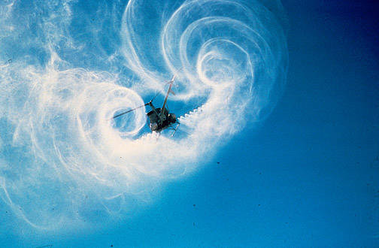
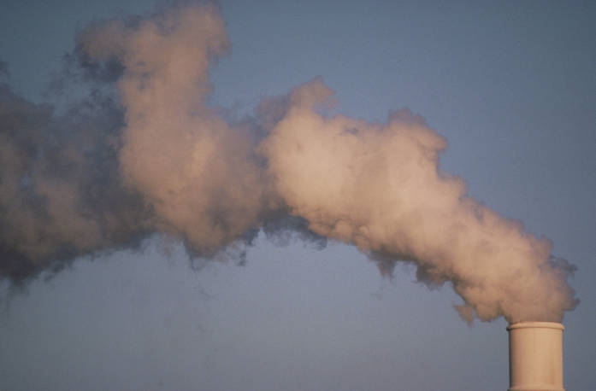
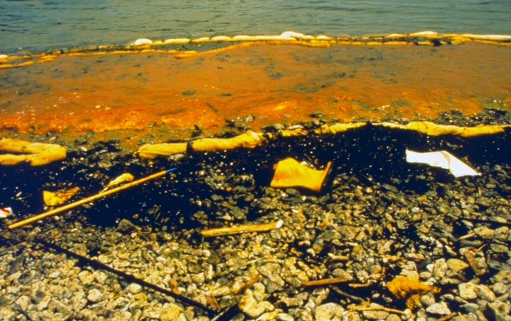
Pollution
Notes:
TitlePollution CreatorPhoto Subjectair pollution smokestack contaminants PublisherU.S. Fish and Wildlife Service ContributorsDIVISION OF PUBLIC AFFAIRS TypeStill image FormatJPG SourceWO4430-Highlights LanguageEnglish RightsPublic domain
Trash left on roadway. Image ID: mvey0061, NOAA's Small World Collection Location: Truk, Caroline Islands Photographer: Dr. James P. McVey, NOAA Sea Grant Program
TitleHelicopter Spraying CreatorJohns, Brad E. SubjectHabitat restoration Spray Pollution Crop Dusting PublisherU.S. Fish and Wildlife Service ContributorsDIVISION OF PUBLIC AFFAIRS TypeStill image FormatJPG SourceWO-Habitat Problems-2677 LanguageEnglish RightsPublic domain
A boom is deployed to contain oil at the spill site.
Image ID: r000wp02, NOAA's Restoration Center Collection Location: Narragansett Bay, RI Photo Date: June 1989 Credit: NOAA Damage Assessment and Restoration Program

Slide 23
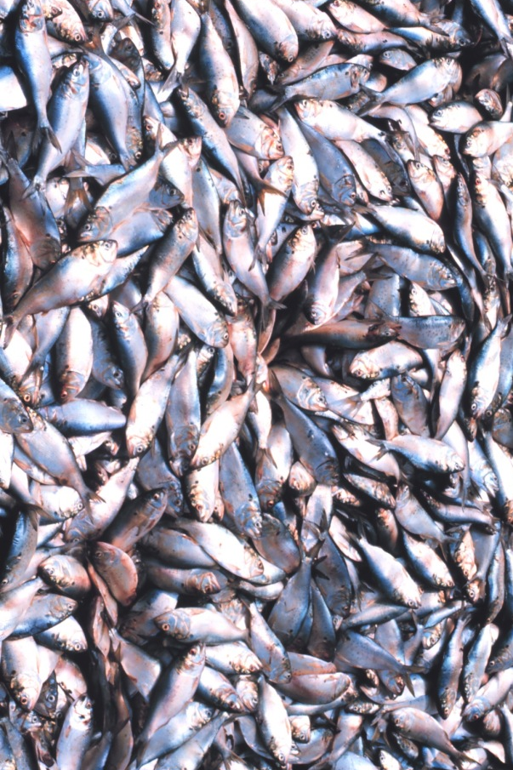
Overexploitation

Slide 24
Saving Endangered Species

